Slide 1
Azure Administration

Slide 2




Cloud
Pay As You Go Model
Opex vs Capex – Cloud Model is based on Opex
High Availability
Cost Optimization
Security
Scalabilty
Elasticity
Disaster Recovery
Fault Tolerance
Catalyst for AI

Slide 3
Azure
Public Cloud Offering

Slide 4
Azure Portal
Lets you build, manage and monitor everything from simple web apps to complex cloud application in a single unified console.
Search resources, services and docs
Manage Resources
Create Customized dashboards and favorites
Access the Cloud Shell
Receive notifications
Links to Azure documentation
Portal.azure.com

Slide 5
Azure Mobile App
Microsoft Azure app helps you keep track of your resources while you are on-the-go.
Stay connect to cloud and check metrics
Diagnose and fix issue
Run commands to manage your Azure resources.

Slide 6
Azure Cloud Shell
Azure Cloud shell is interactive browser accessible shell.
Run Powershell as well as CLI commands.

Slide 7
Azure CLI
https://learn.microsoft.com/en-in/cli/azure/install-azure-cli
CLI Commands - https://learn.microsoft.com/en-in/cli/azure/reference-index?view=azure-cli-latest

Slide 8
Azure PowerShell
https://learn.microsoft.com/en-in/powershell/azure/install-az-ps?view=azps-8.3.0
PowerShell commands - https://learn.microsoft.com/en-in/powershell/module/az.accounts/?view=azps-8.3.0#accounts

Slide 9
Azure Resource Manager

Slide 10
Resource Manager
Enables you to work with the resources in your solution as a group.
You can deploy, update or delete all the resources for your solution in one single coordinated operation.

Slide 11
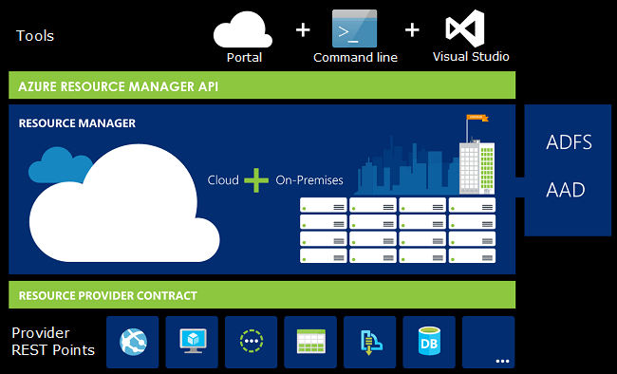




Slide 12
Benefits
You can deploy, manage and monitor the resources in your solution as a group
You can repeatedly deploy your solution in the same consistent state

Slide 13
Terminology
Resource – Manageable item that is available through azure. Ex: Virtual Machine, Storage Account, Web App, Database, Virtual Network
Resource Group – Container that hold the related resources for an azure solution
Resource Provider – A service that supplies the resources you can deploy and manage through the Resource Manager. Ex: Microsoft.Compute – Virtual Machine, Microsoft.Storage – Storage Account

Slide 14
Resource Group
Logical collection of resources
Resources can only exist in one resource group
Resource Groups cannot be renamed
Resource groups can have resources of many different types
Resource groups can have resources from many different regions.

Slide 15



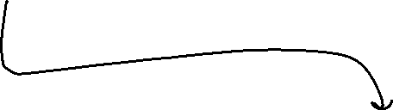







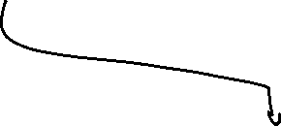

Slide 16







Slide 17
Creating Resource Group
Deploying a resource to resource group

Slide 18
Resource Manager Locks
Allows to put a structure in place that prevents the accidental deletion of resources in Azure.
Two Types:
Read-only lock – prevent any changes to the resource
Delete lock – prevent the deletion

Slide 19
Moving Resources
https://learn.microsoft.com/en-us/azure/azure-resource-manager/management/move-support-resources

Slide 20
Deleting Resources and Resource Groups
Please be cautious while deleting resource group.
Once deleted, resource groups cannot be recovered.

